Slide 1


Necro Nursery
Team Abra-cadaver

Slide 2
Who are we?
Drew - Design Lead / Programmer
Brooke - Project Manager / Programmer
Riley - Admin / Programmer
Nicholas - Marketing / Art
Jackson - Marketing / Programmer
Garrett - QA / Audio
Ian - Narrative

Slide 3
Pitch
Take on your necromancy apprenticeship by helping your mentors raise the dead. It’s your job to get the living dead “sprouts” started before handing it off to the masters. Revel in the feeling of either bringing the dead back to life or making them so extra dead that even the masters can’t bring them back.

Slide 4
Design Challenges
Finding a way to categorize the resources/monsters/other resources
Balancing the different resources, as we're not doing time based
Art consistency between different cultures
Getting all the music and SFX to sound nice together

Slide 5
Design Pillars
Research real-world monsters, figure out their wants / needs to base our categories on those
Have to work out some math formulas for different levels and monster requirements to keep it as balanced as possible.
Figure a coherent style that can convey the monster in context of the culture without sacrificing visual consistency.
Make sure to get constant feedback on how they sound together, possibly consult the music / audio teachers on campus for their help.

Slide 6
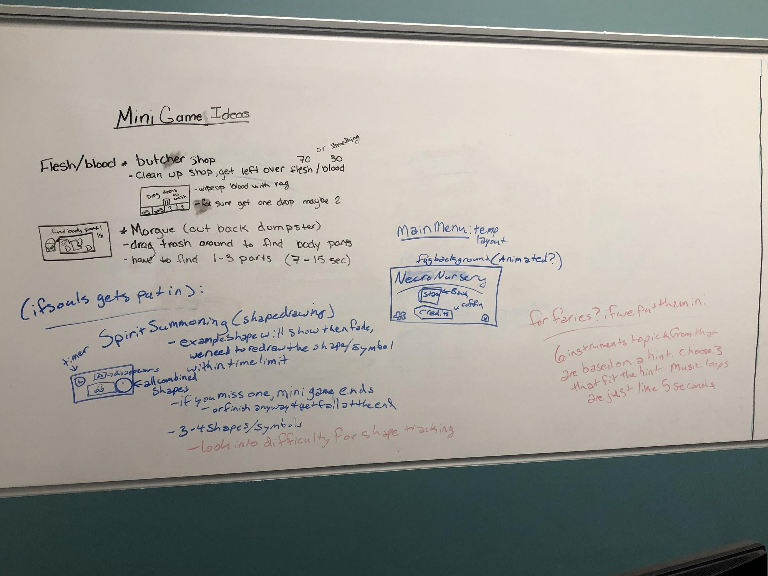
Narrative
Resource Categories
Monster ideas
Brainstorming minigames
Butcher Shop
Morgue

Slide 7
Audio
Created background sound effects
Music soundtracks for all current scenes
Main menu
Graveyard theme
Market theme
Ambience for whatever we need

Slide 8
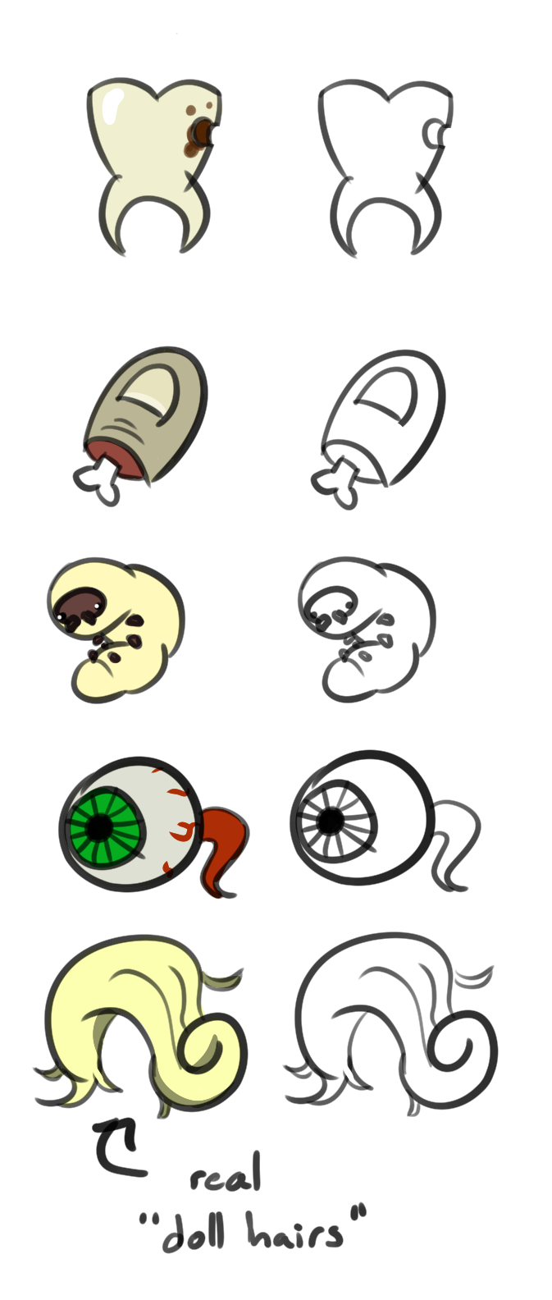
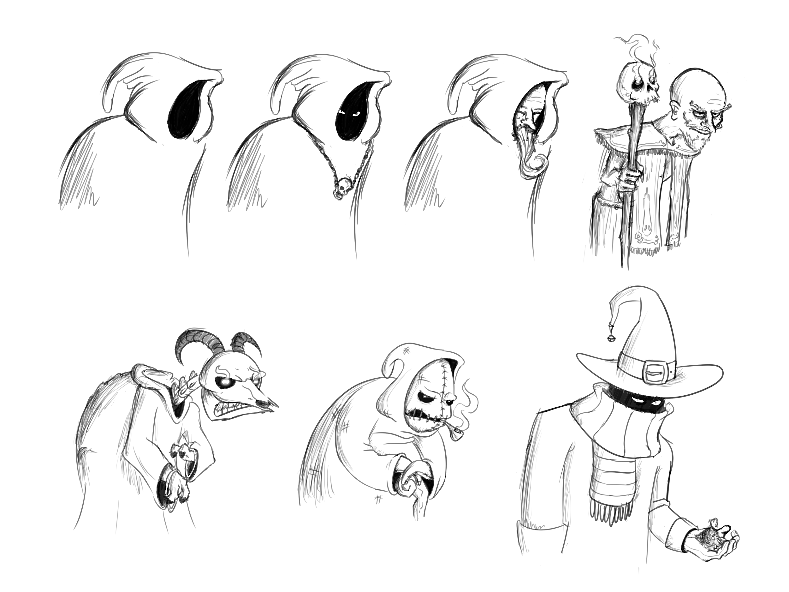
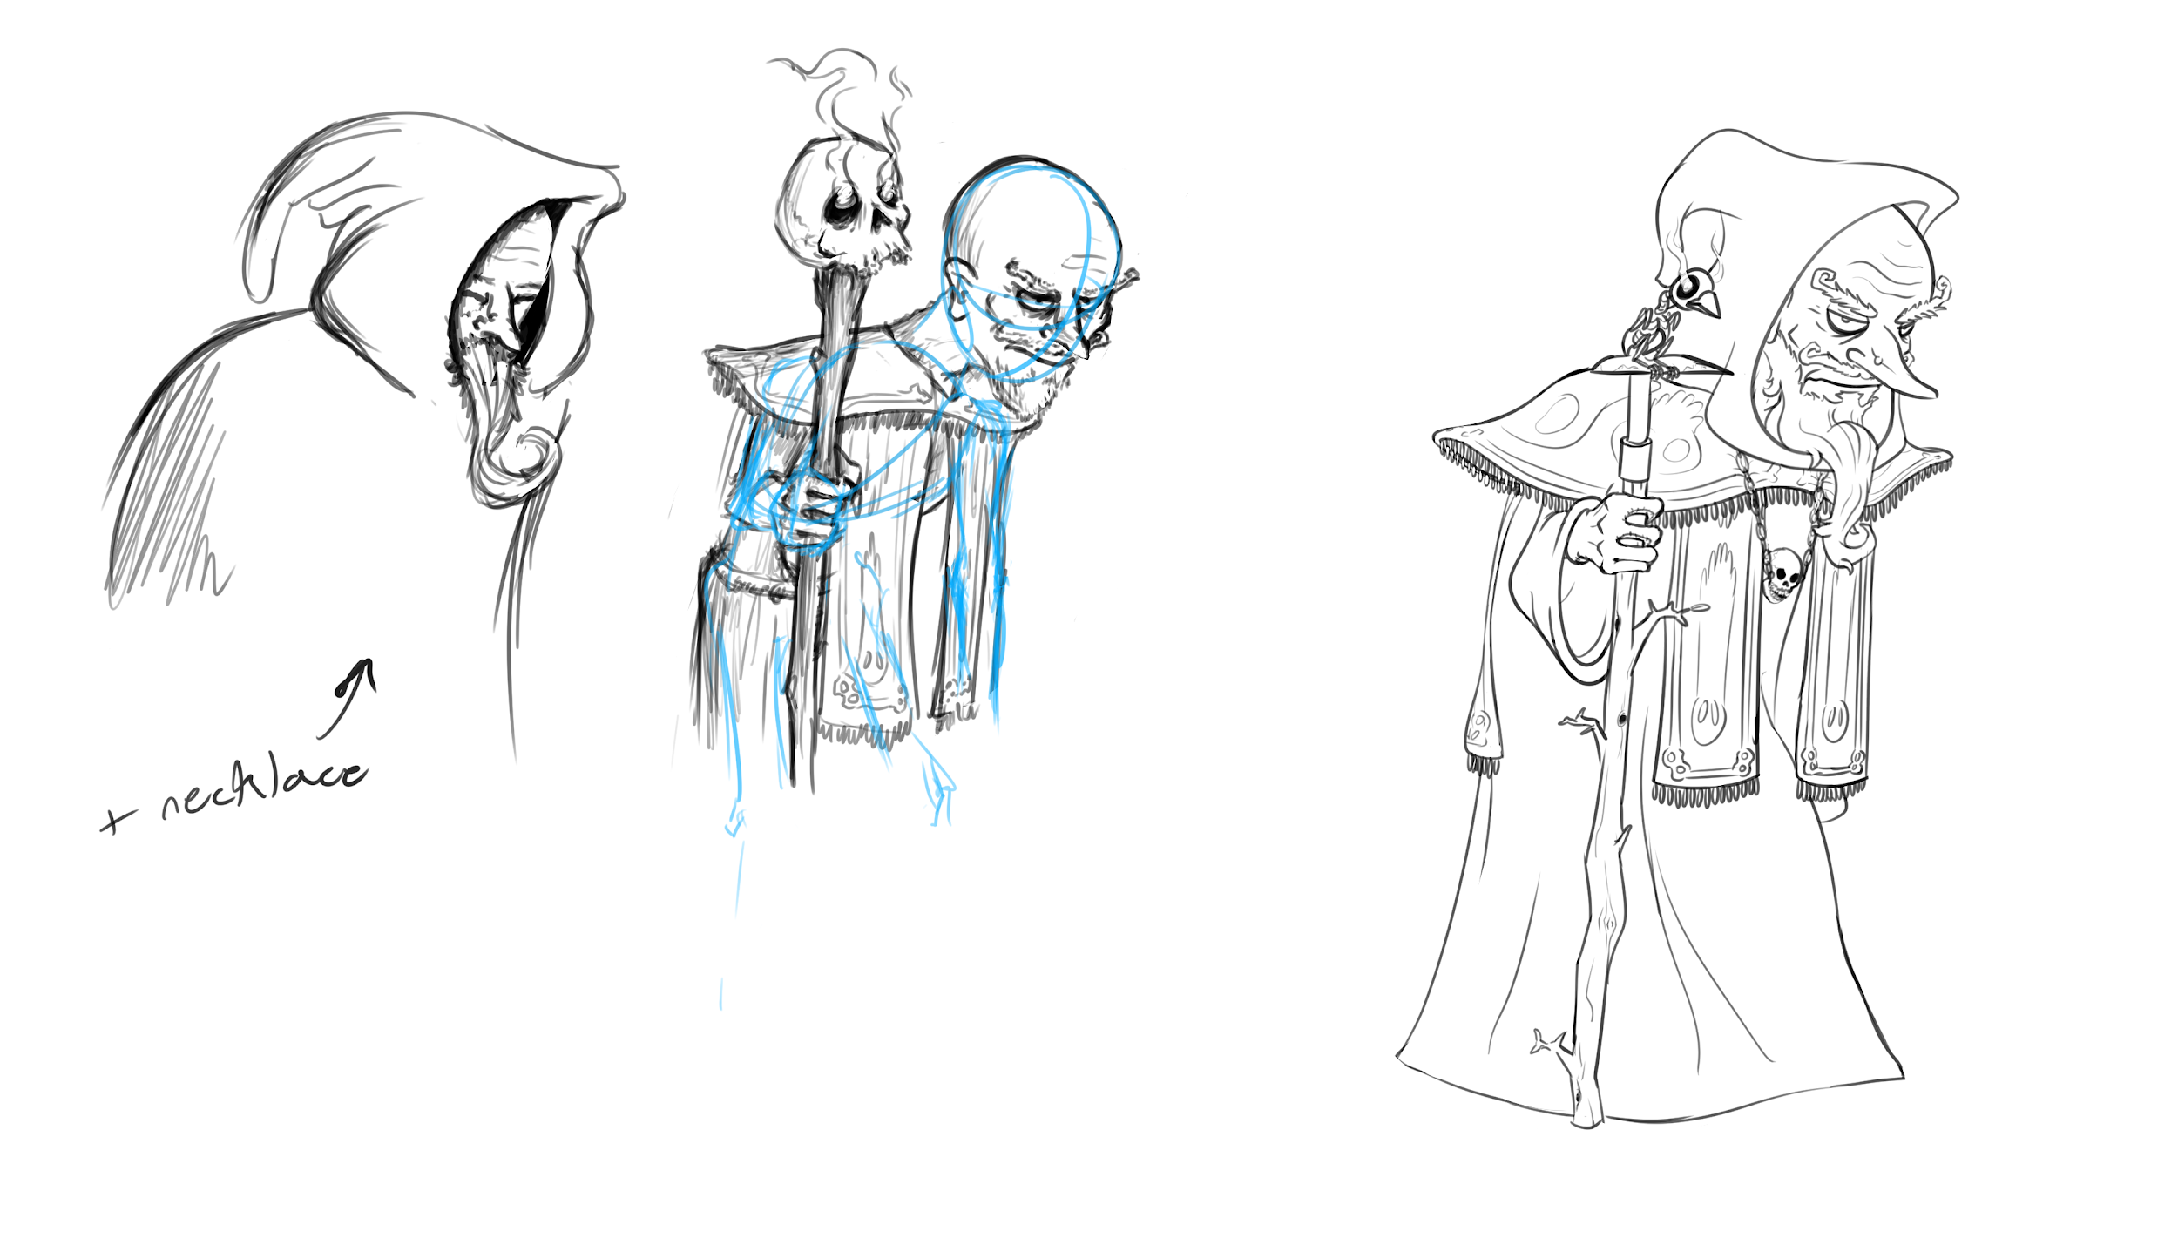
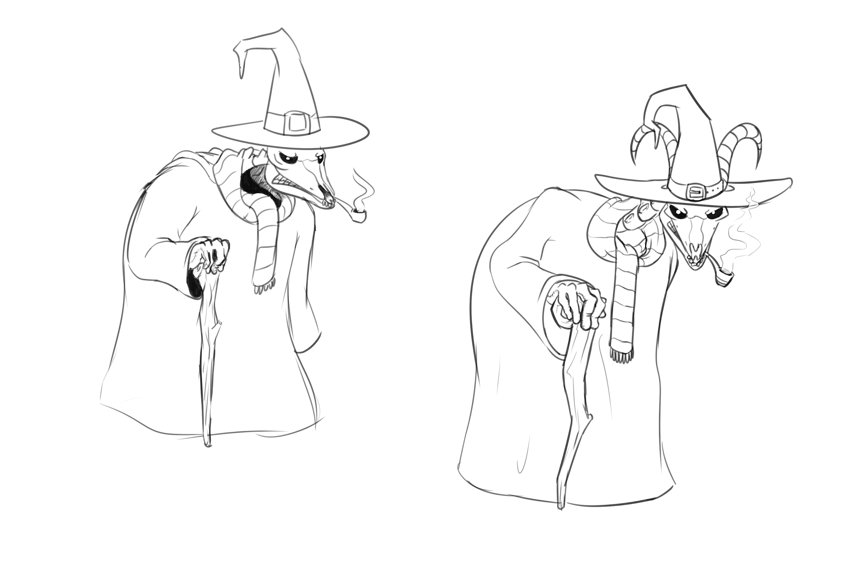

Slide 9
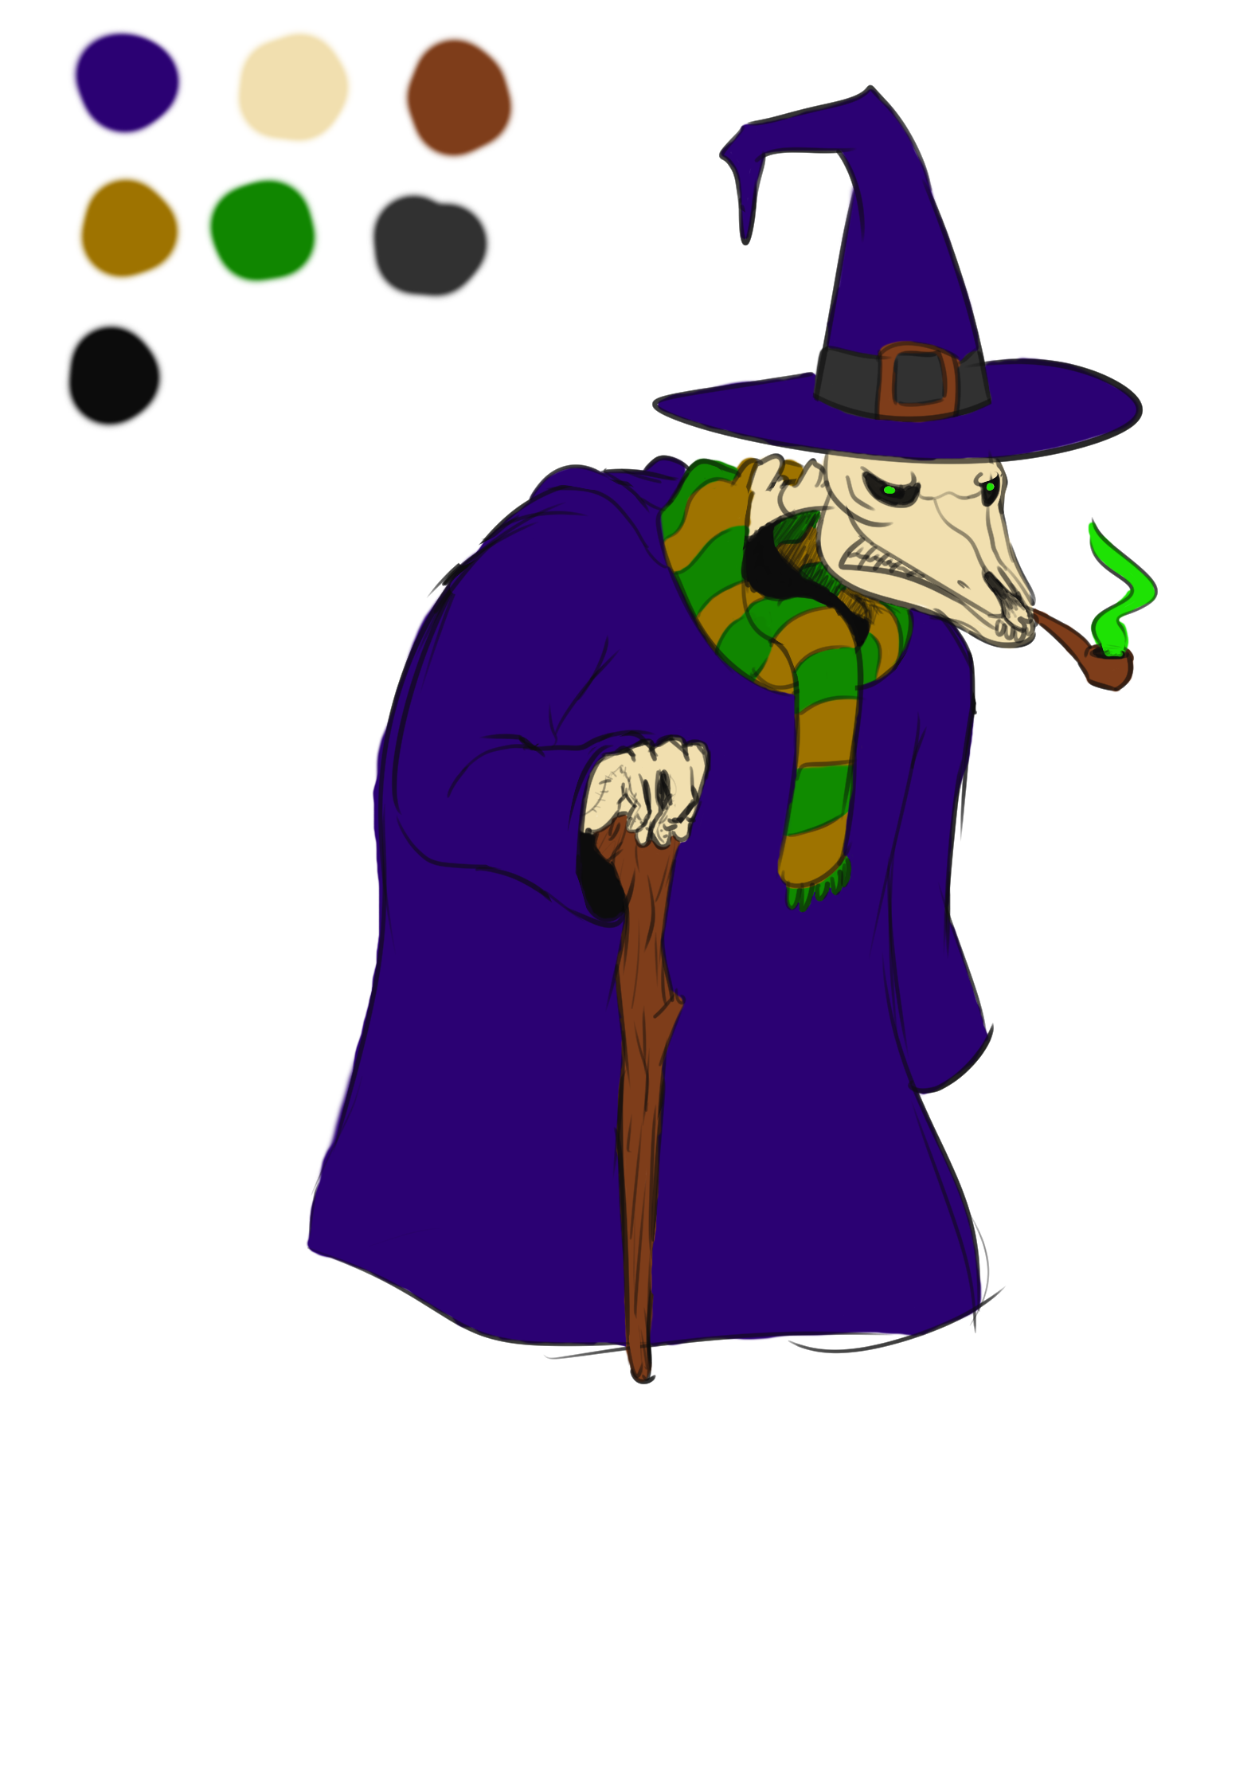
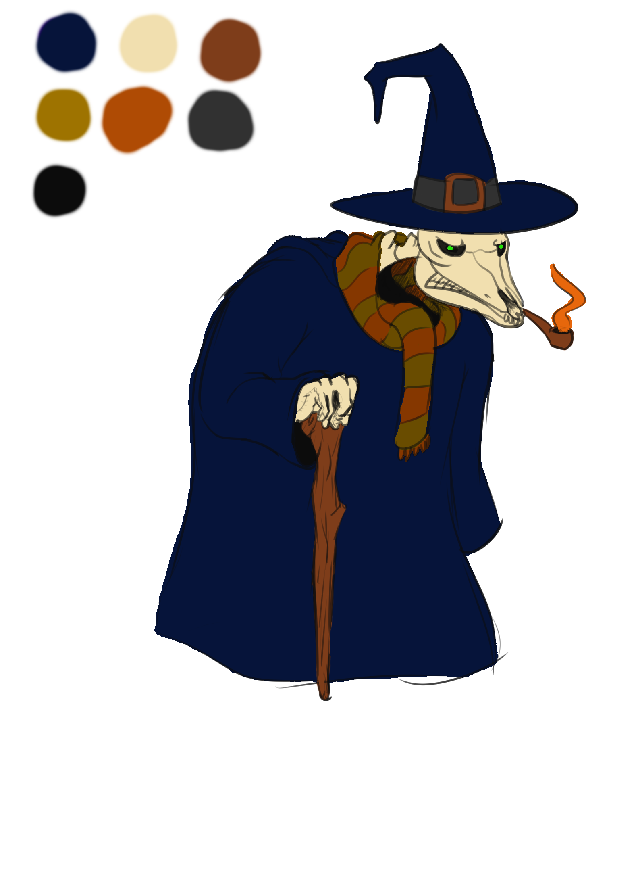
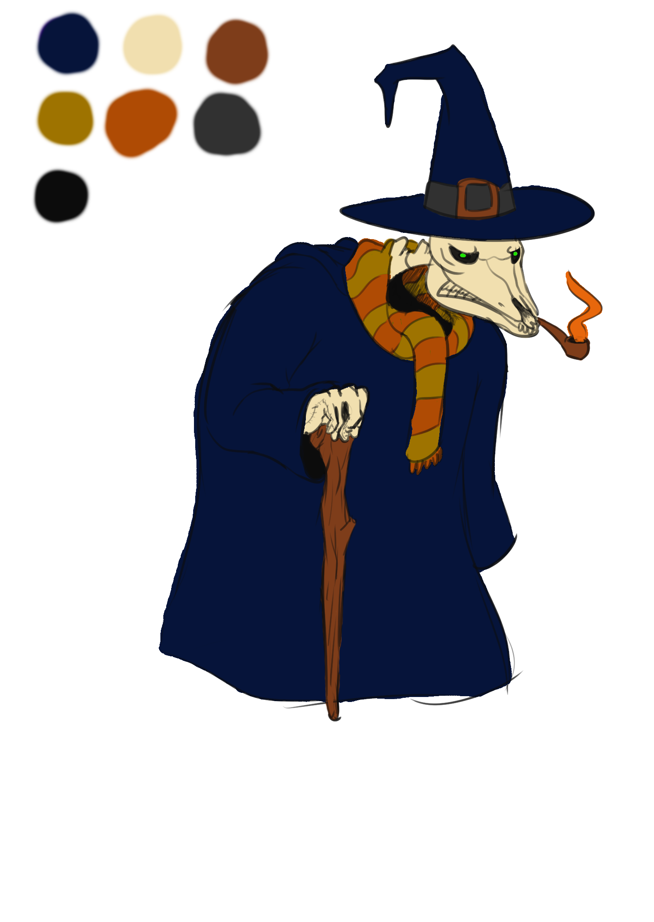
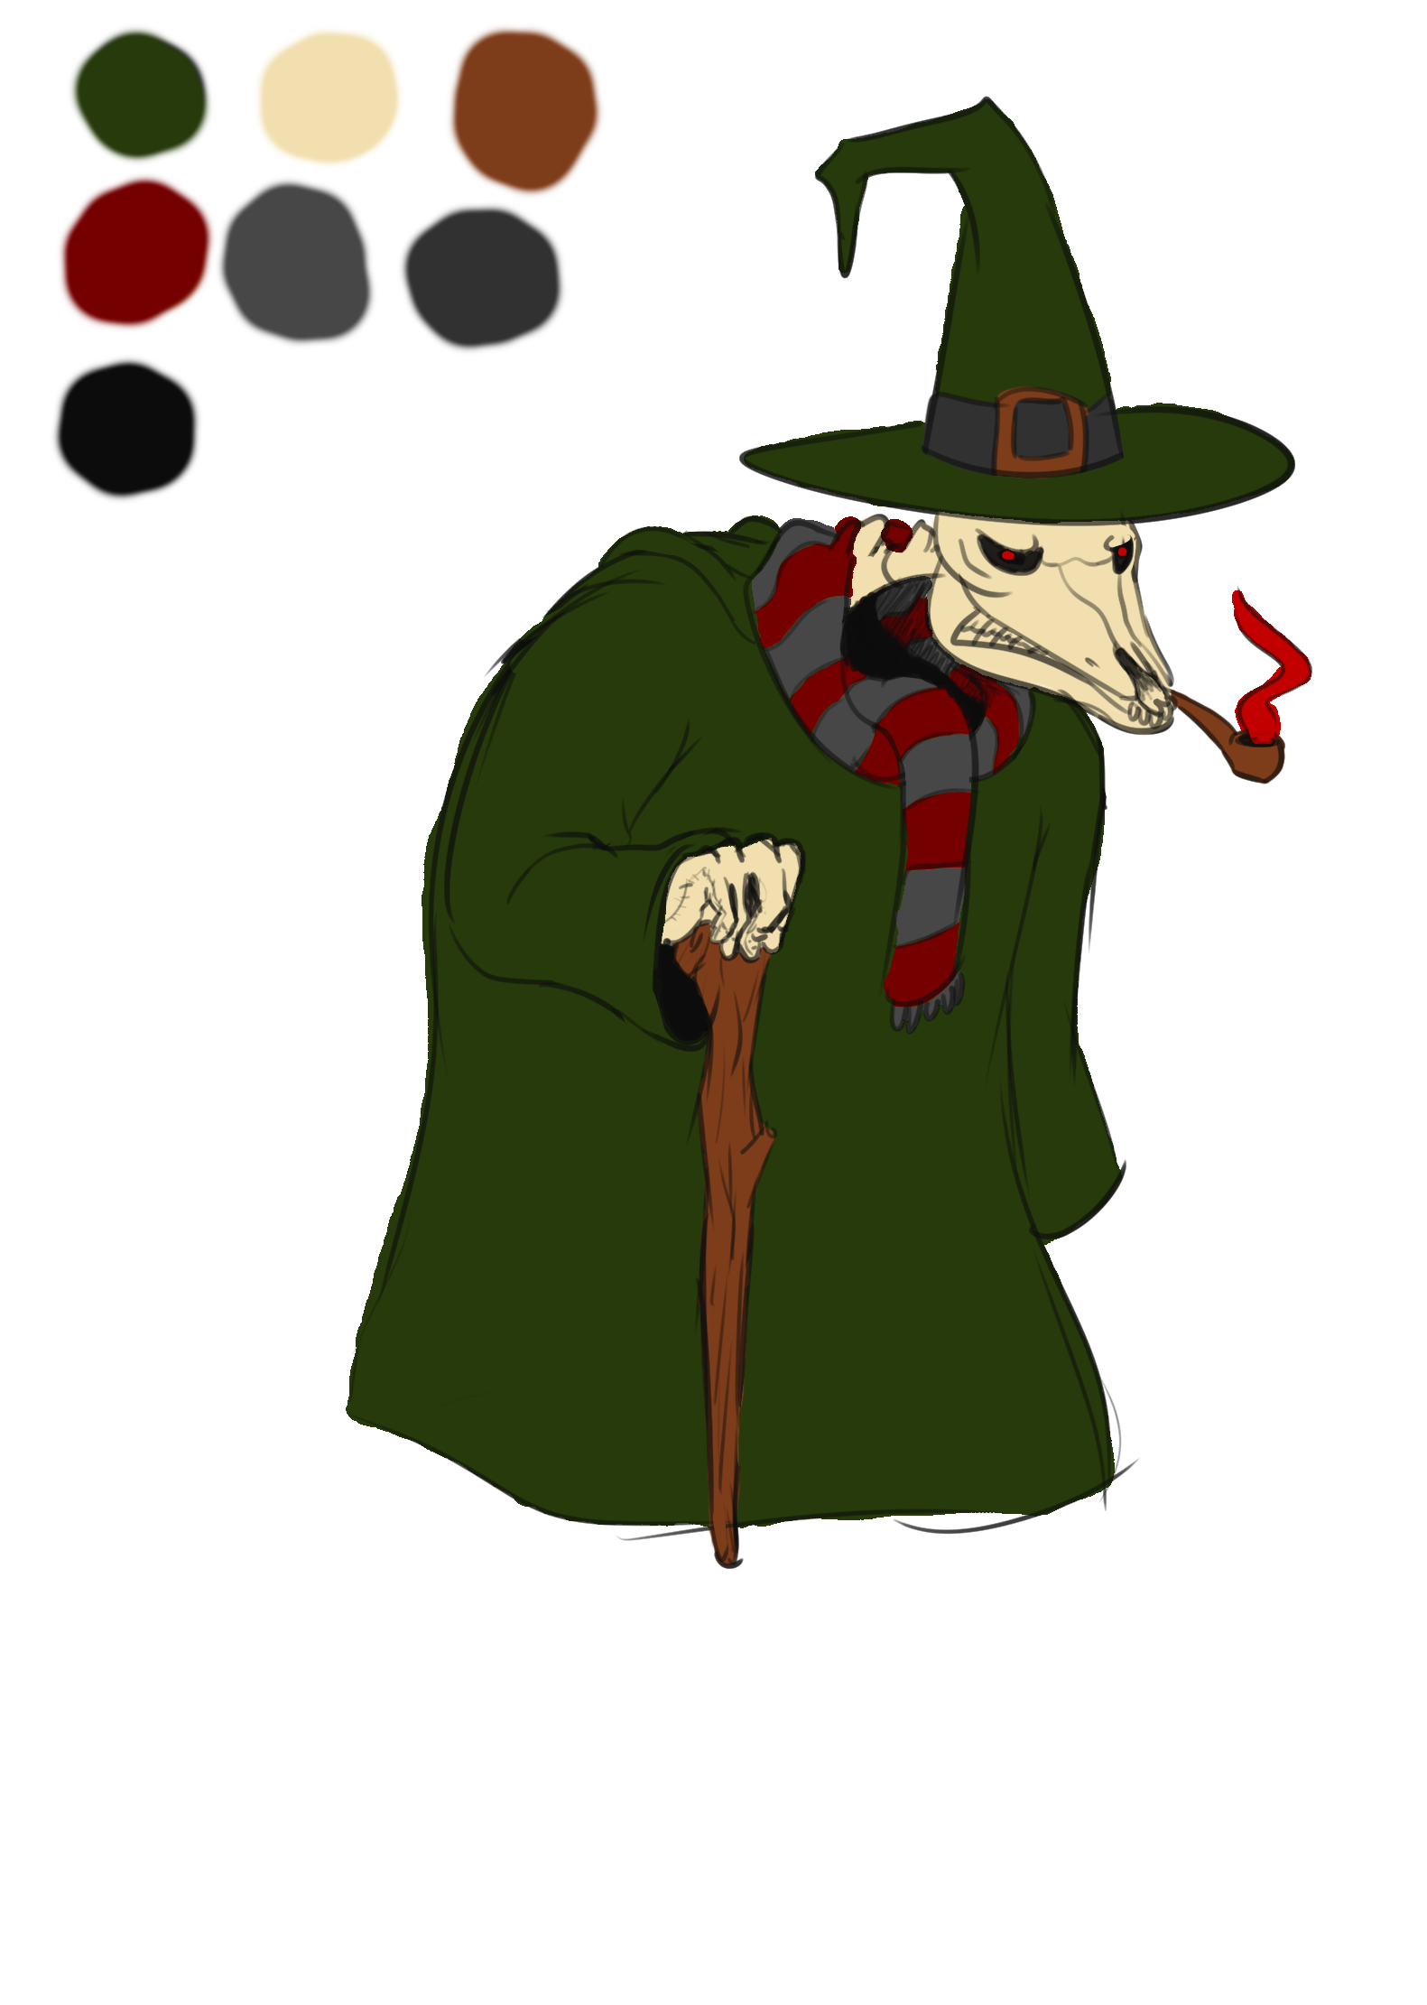

Slide 10
Programming
White boxing
Graveyard
Marketplace
Set up temporary Git server
Swipe to move screen
Tapping a grave shows a blank canvas
Basic marketplace logic
Resource management

Slide 11
What we plan to do!
Begin programming the Morgue minigame
Continue work on Graveyard Scene and Market Scenes
Continue constant playtesting
Begin “full” playtesting once a playable build is created

Slide 12
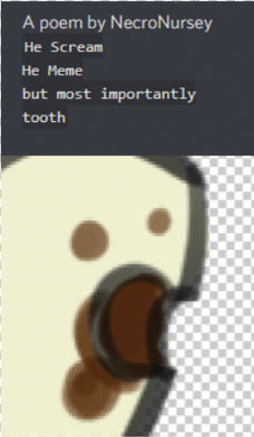
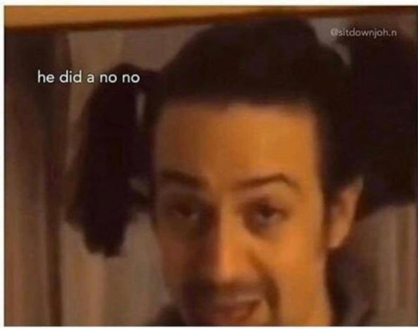
Questions?

